Slide 1
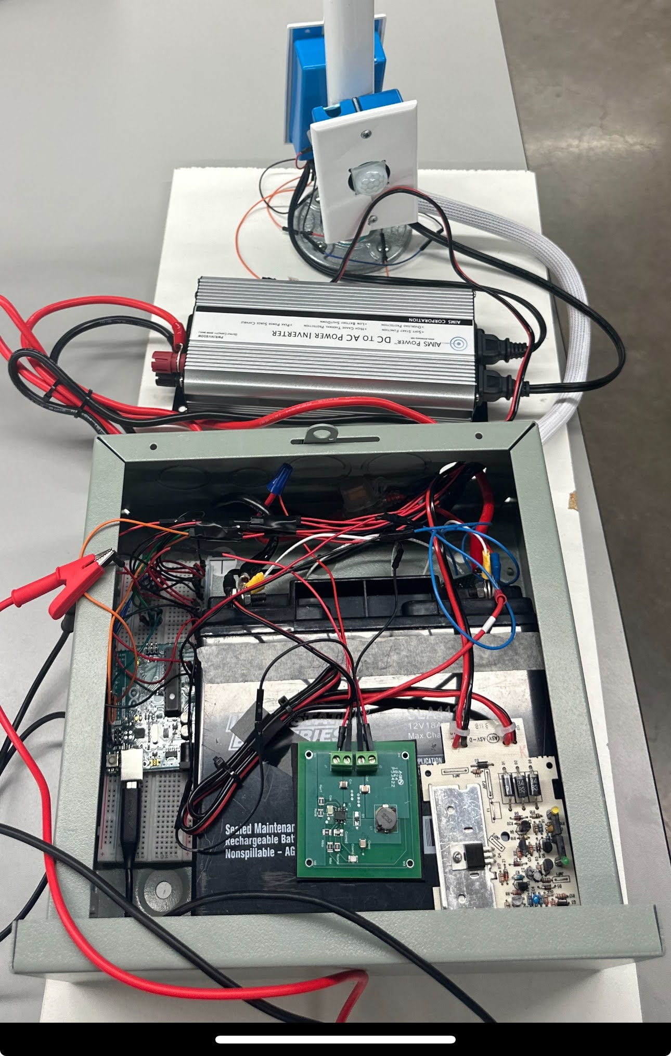
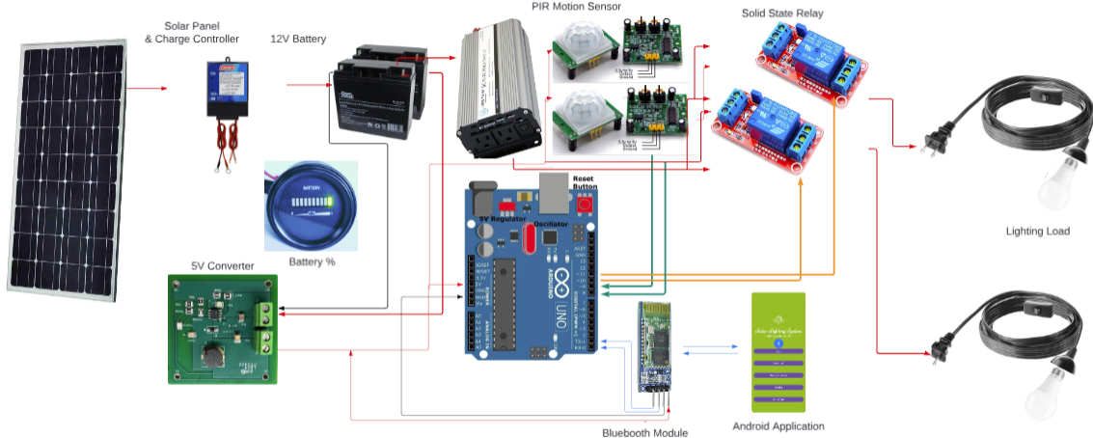
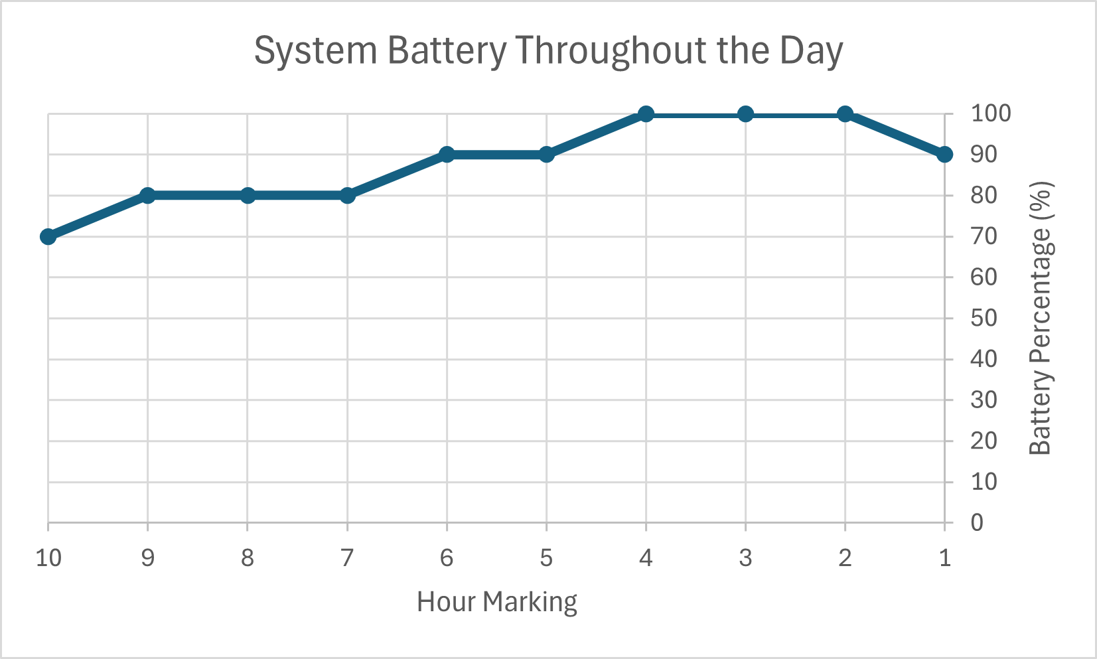
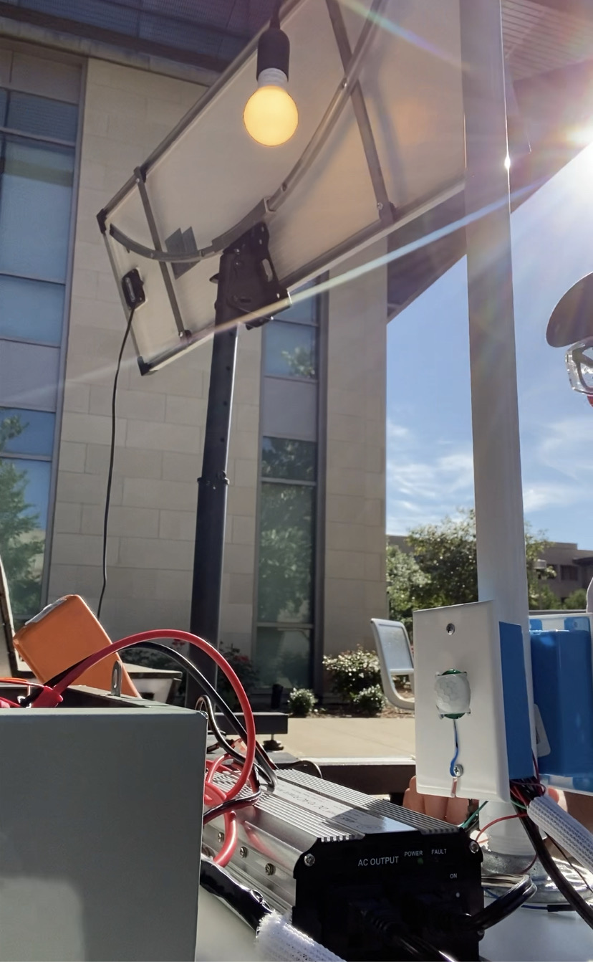
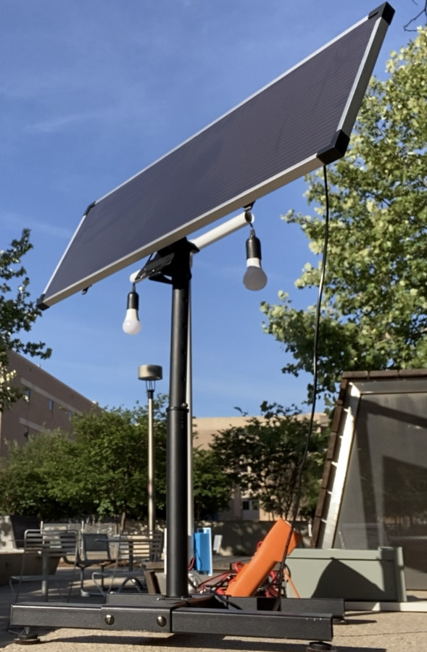
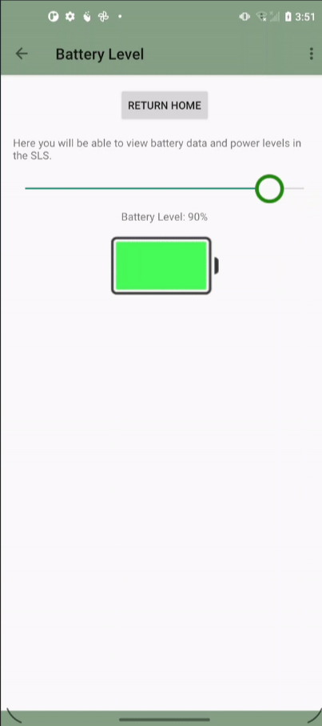
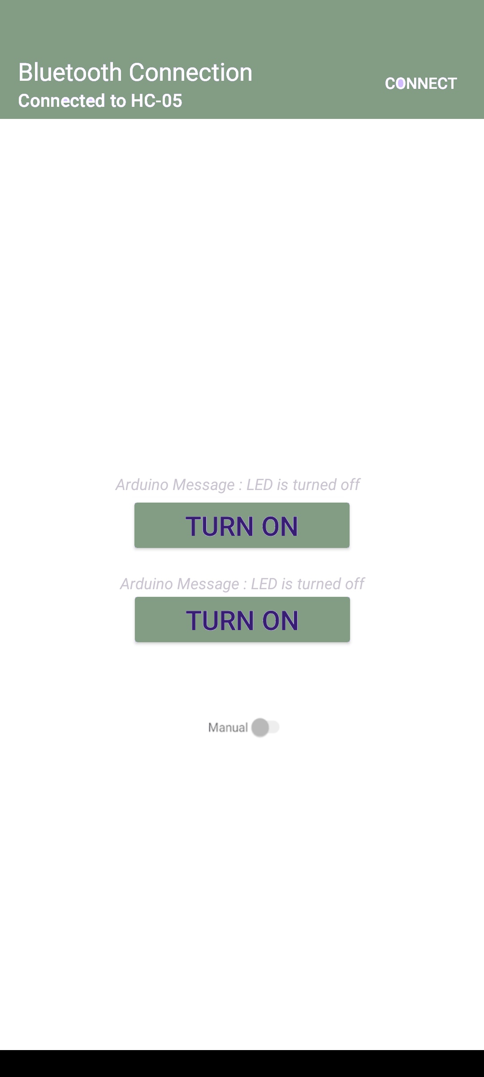
EPS Booth: E19
Solar Lighting System
Josh George, Lyric Haylow, Jeb Malek
Dr. Wonhyeok Jang
Electrical and Computer Engineering
Problem Definition
As renewable energy sources are becoming more widespread, a drive to incorporate Solar Panels into normal household applications led to this project. Our team has been tasked with creating a self-powered autonomous lighting system that’s controlled through a mobile application.
Engineering Analysis
Our project is unique in the fact that it uses solar charge control to charge a battery. Furthermore, using Bluetooth to control system mode of operations and receive system data posed additional challenges:
The solar charge controller design verification, with large amounts of current making selection of components and trace sizes difficult.
Power delivery systems testing presented challenges in the DC/AC Inverter, and DC Converter regulation to constant output voltage.
Validation of the motion sensor’s presented difficulty with sensitivity , and digital signal time delays and Arduino processing for switch control.
The mobile app was coded on Android Studio and connects to an Arduino Uno & HC-05 Bluetooth to complete with the wireless system.
Table 2. Power Requirements
Supply | Voltage | Current | Power
Bluetooth Module | 4.91 V | 40mA | 185mW
Arduino | 4.91 V | 37-40 mA | 185-200 mW
Switches | 4.91 V | 10mA | 180mW
Sensors | 4.91 V | 1-2mA | 4.91-9.82 mW
 |  | DC Total | 550-565 mW
AC Light Load | 120V RMS | 180-200 mA | 21-22W
 |  | Nom. Total | 23W
Methodology
The solar lighting system includes 4 subsystem: the solar charge controller, the power inverter, the microcontroller unit, and the mobile application.
Mobile Application
Developed an Android application that controls lights manually , toggles to motion sensing mode
Microcontroller
Developed Arduino code to control relay’s digital signals provided by motion and app connection
Power
Assembled 12 - to - 5V Buck Converter, 120VAC Modified Sine Wave Inverter.
Solar Charge Controller
MPPT (Maximum Power Point Tracking)
Constant Voltage, Overvoltage Protect
Here is the data for the power requirements of the components coming out of the battery. As shown in previous graph, expected nominal lifetime with these listed power requirements is ~9 hours.
Figure 2. Integrated System Image
Functional Block Diagrams
Impact
The solar lighting system allows homeowners to reduce utility expenses through renewable energy sources, and overall helps the power grid in reducing load. For our team, it helped us in learning:
Design and implementation of power system converters.
Detailed multi-layered PCB design for large current power systems.
Mobile Application design and Bluetooth implementation in Arduino microcontroller.
Figure 2. Battery Percentage across 10-hour history, taken from mobile app.
Outcomes
Our project was able to successfully make the lights work with motion sensing control, as well as make a manual option for them. Unforeseen complications with our mobile application led to no further functions within the app. We also decided to remove the flood light from our initial design, as the power demand would be too great.
References
IEEE 1562-2021 Recommended Practice for Sizing of Stand-Alone Photovoltaic
BQ24650 Stand-Alone Synchronous Buck Battery Charge Controller for Solar Power With Maximum Power Point Tracking
bq24650EVM Synchronous, Switch-Mode, Battery Charge Controller for Solar Power
Table 1. Charge Control Requirements
Specification | Min | Nominal | Max
Solar Panel Input Voltage (V) | 5 | 21 | 25
Solar Panel Input Current (A) | 1 | 1.2 | 1.5
Charge Controller output current (A) | 0.5 | 2 | 10
Battery Voltage (V) | 2.1 | 12 | 26
Estimated Battery Life (hours) | 5.4 | 9 | 27
Figure 1. Multiple angles of the Solar Lighting System.
Figure 2. Battery Percentage readings and mode of operation
Acknowledgements
Dr. Wonhyeok Jang, Dr. John Lusher, Pranav Dhulipala, Rhett Guthrie

